Slide 1
Segment Tree

Slide 2
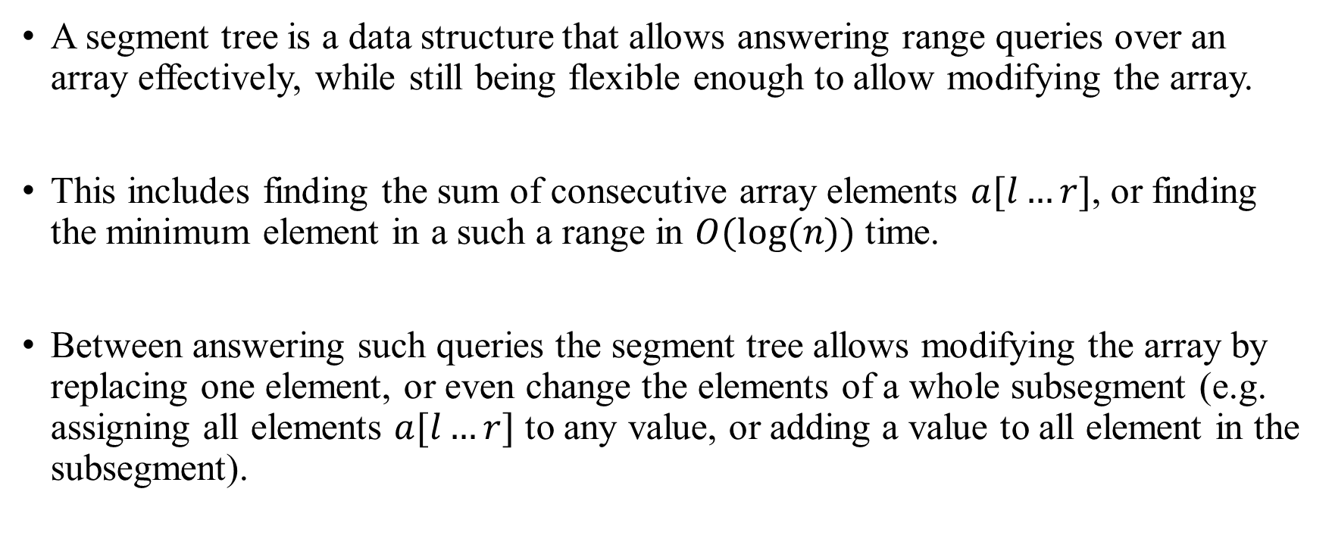
Segment Tree
A segment tree is a data structure that allows answering range queries over an array effectively, while still being flexible enough to allow modifying the array.
This includes finding the sum of consecutive array elements $a[l…r]$, or finding the minimum element in a such a range in $O(log⁡(n))$ time.
Between answering such queries the segment tree allows modifying the array by replacing one element, or even change the elements of a whole subsegment (e.g. assigning all elements $a[l…r]$ to any value, or adding a value to all element in the subsegment).

Slide 3
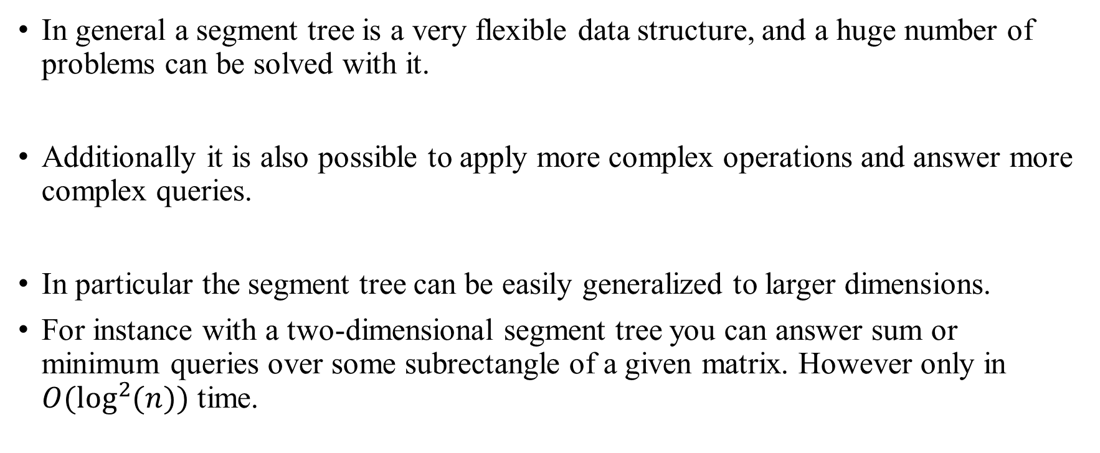
Segment Tree
In general a segment tree is a very flexible data structure, and a huge number of problems can be solved with it.
Additionally it is also possible to apply more complex operations and answer more complex queries.
In particular the segment tree can be easily generalized to larger dimensions.
For instance with a two-dimensional segment tree you can answer sum or minimum queries over some subrectangle of a given matrix. However only in $O(\log^{2}{(n)})$ time.

Slide 4

Segment Tree Memory
One important property of segment trees is, that they require only a linear amount of memory.
The standard Segment Tree requires $4∙n$ vertices for working on an array of size $n$.

Slide 5
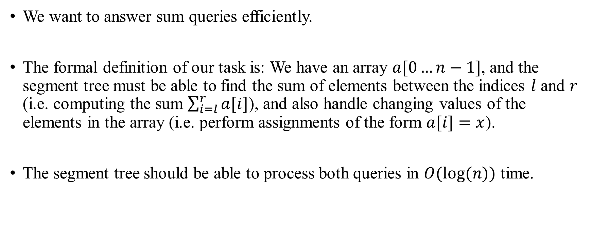
Segment Tree Problem definition
We want to answer sum queries efficiently.
The formal definition of our task is: We have an array $a[0…n−1]$, and the segment tree must be able to find the sum of elements between the indices $l$ and $r$ (i.e. computing the sum $\sum_{i=l}^{r}{a[i]}$), and also handle changing values of the elements in the array (i.e. perform assignments of the form $a[i]=x$).
The segment tree should be able to process both queries in $O(log⁡(n))$ time.

Slide 6
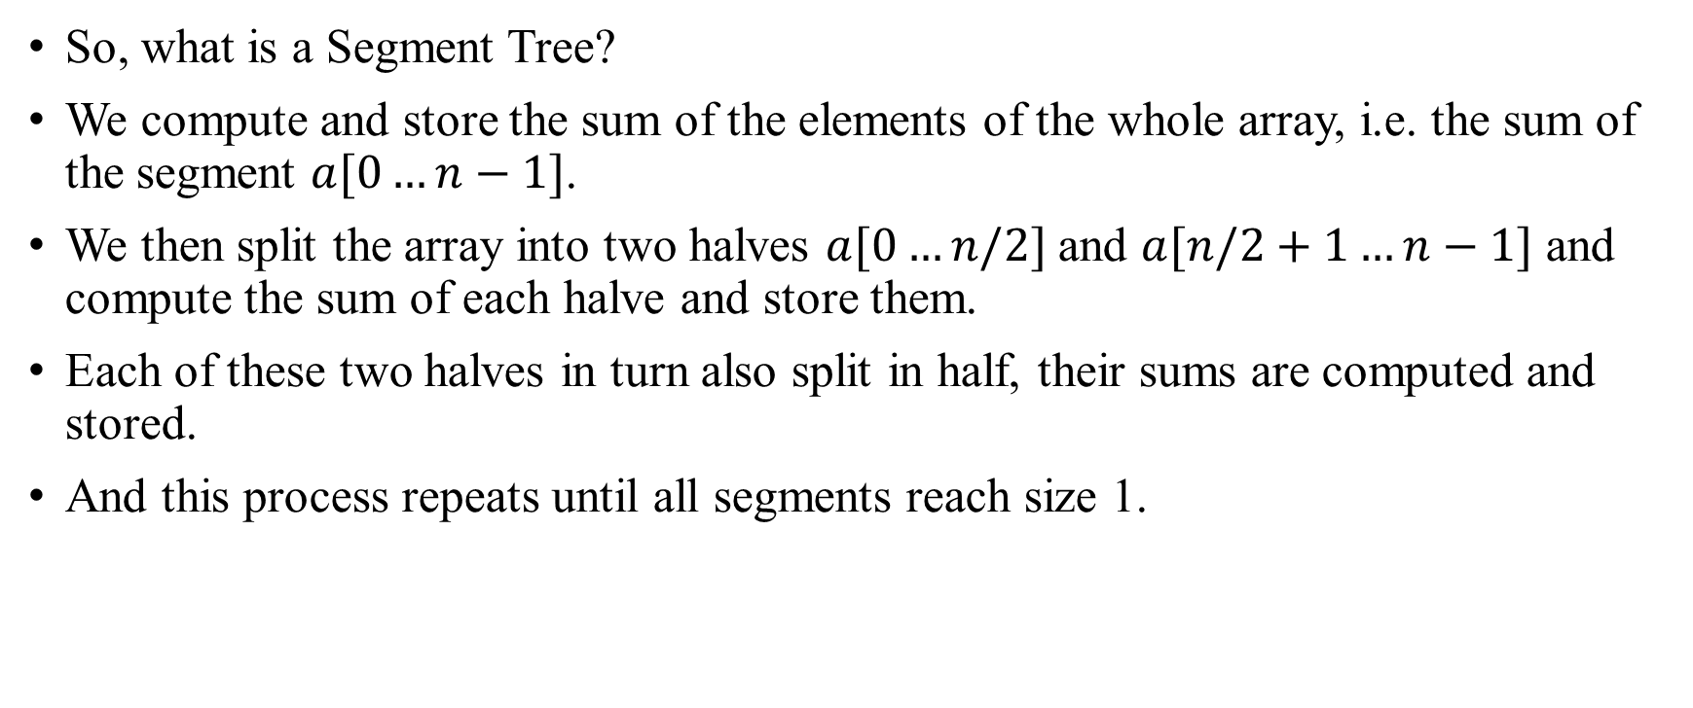
Segment Tree Structure
So, what is a Segment Tree?
We compute and store the sum of the elements of the whole array, i.e. the sum of the segment $a[0…n−1]$.
We then split the array into two halves $a[0…n/2]$ and $a[n/2+1…n−1]$ and compute the sum of each halve and store them.
Each of these two halves in turn also split in half, their sums are computed and stored.
And this process repeats until all segments reach size 1.

Slide 7
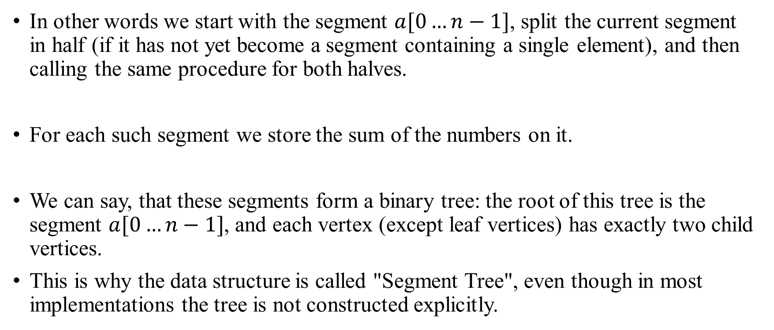
Segment Tree Structure
In other words we start with the segment $a[0…n−1]$, split the current segment in half (if it has not yet become a segment containing a single element), and then calling the same procedure for both halves.
For each such segment we store the sum of the numbers on it.
We can say, that these segments form a binary tree: the root of this tree is the segment $a[0…n−1]$, and each vertex (except leaf vertices) has exactly two child vertices.
This is why the data structure is called "Segment Tree", even though in most implementations the tree is not constructed explicitly.

Slide 8
Segment Tree Example
Here is an example of such a Segment Tree over the array a=[1,3,−2,8,−7]:
1 | 3 | -2 | 8 | -7
sum = 3
1 | 3 | -2
8 | -7
sum = 2
sum = 1
1 | 3
-2
8
-7
sum = 4
sum = -2
sum = 8
sum = -7
1
3
sum = 1
sum = 3

Slide 9
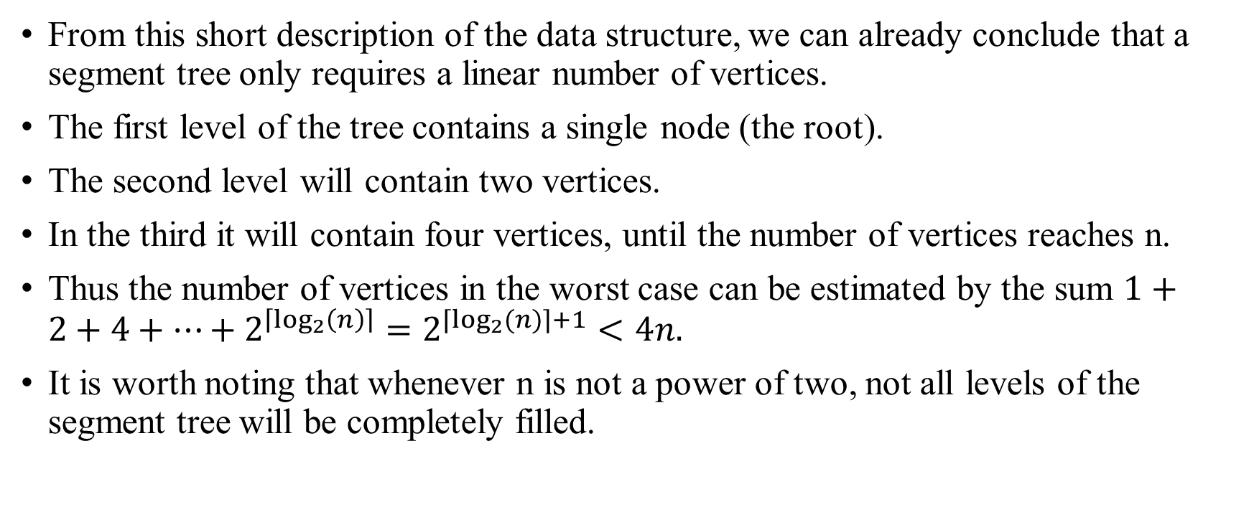
Segment Tree Number of nodes
From this short description of the data structure, we can already conclude that a segment tree only requires a linear number of vertices.
The first level of the tree contains a single node (the root).
The second level will contain two vertices.
In the third it will contain four vertices, until the number of vertices reaches n.
Thus the number of vertices in the worst case can be estimated by the sum $1+2+4+⋯+2^{\left\lceil \log_{2}\left(n\right)\right\rceil }=2^{⌈\log_{2}(n)⌉+1}<4n.$
It is worth noting that whenever n is not a power of two, not all levels of the segment tree will be completely filled.

Slide 10

Segment Tree Height
The height of the Segment Tree is $O(log⁡(n))$, because when going down from the root to the leaves the size of the segments decreases approximately by half.

Slide 11
Segment Tree Construction
A Segment Tree can be constructed efficiently as follows.
We start at the bottom level, the leaf vertices.
A vertex is a leaf vertex, if its corresponding segment covers only one value.
Therefore we can simply copy the values of the elements a[i].
On the basis of these values, we can compute the sums of the previous level.
And on the basis of those, we can compute the sums of the previous, and repeat the procedure until we reach the root vertex.

Slide 12
Segment Tree Construction
It is convenient to describe this operation recursively: we start the construction at the root vertex and the construction procedure, if called on a not-leaf vertex, first recursively constructs the two child vertices, and than sums up the computed sums of these children.
If it is called on a leaf vertex, it simply uses the value of the array.
The time complexity of the construction is O(n).

Slide 13
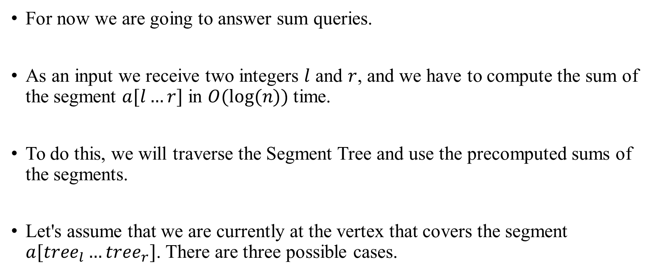
Segment Tree Sum queries
For now we are going to answer sum queries.
As an input we receive two integers $l$ and $r$, and we have to compute the sum of the segment $a[l…r]$ in $O(log⁡(n))$time.
To do this, we will traverse the Segment Tree and use the precomputed sums of the segments.
Let's assume that we are currently at the vertex that covers the segment $a[tree_{l}…tree_{r}]$. There are three possible cases.

Slide 14
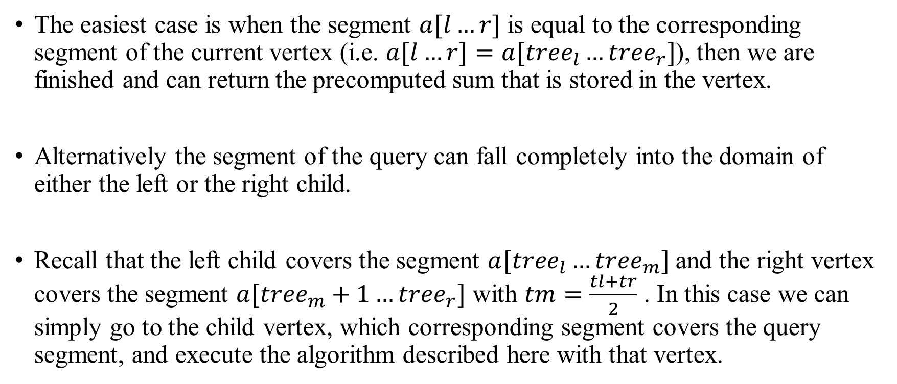
Segment Tree Sum queries
The easiest case is when the segment $a[l…r]$ is equal to the corresponding segment of the current vertex (i.e. $a[l…r]=a[tree_{l}…tree_{r}]$), then we are finished and can return the precomputed sum that is stored in the vertex.
Alternatively the segment of the query can fall completely into the domain of either the left or the right child.
Recall that the left child covers the segment $a[tree_{l}…tree_{m}]$ and the right vertex covers the segment $a[tree_{m}+1…tree_{r}]$ with $tm=\frac{tl+tr}{2}$ . In this case we can simply go to the child vertex, which corresponding segment covers the query segment, and execute the algorithm described here with that vertex.

Slide 15
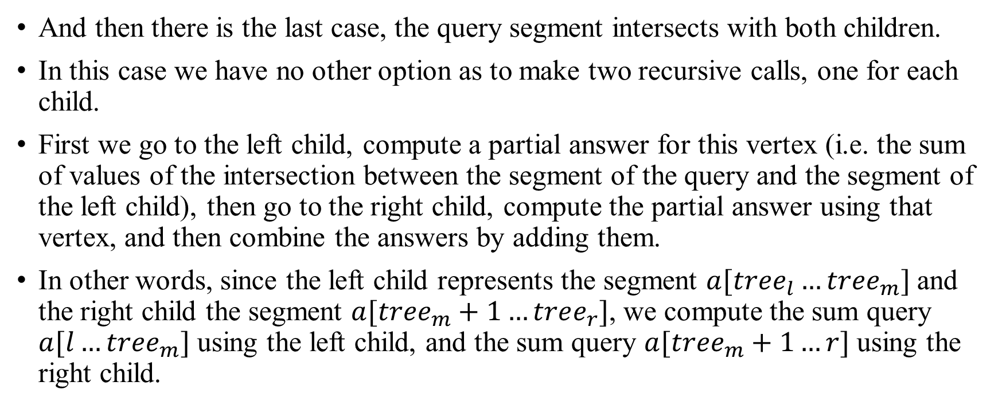
Segment Tree Sum queries
And then there is the last case, the query segment intersects with both children.
In this case we have no other option as to make two recursive calls, one for each child.
First we go to the left child, compute a partial answer for this vertex (i.e. the sum of values of the intersection between the segment of the query and the segment of the left child), then go to the right child, compute the partial answer using that vertex, and then combine the answers by adding them.
In other words, since the left child represents the segment $a[tree_{l}…tree_{m}]$ and the right child the segment $a[tree_{m}+1…tree_{r}]$, we compute the sum query $a[l…tree_{m}]$ using the left child, and the sum query $a[tree_{m}+1…r]$ using the right child.

Slide 16
Segment Tree Sum queries
So processing a sum query is a function that recursively calls itself once with either the left or the right child (without changing the query boundaries), or twice, once for the left and once for the right child (by splitting the query into two subqueries).
And the recursion ends, whenever the boundaries of the current query segment coincides with the boundaries of the segment of the current vertex. In that case the answer will be the precomputed value of the sum of this segment, which is stored in the tree.
In other words, the calculation of the query is a traversal of the tree, which spreads through all necessary branches of the tree, and uses the precomputed sum values of the segments in the tree.

Slide 17
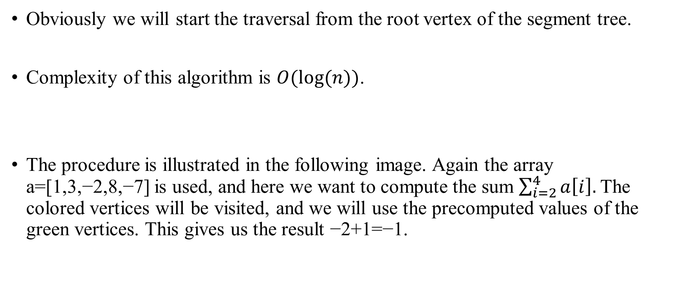
Segment Tree Sum queries
Obviously we will start the traversal from the root vertex of the segment tree.
Complexity of this algorithm is $O(log⁡(n))$.
The procedure is illustrated in the following image. Again the array a=[1,3,−2,8,−7] is used, and here we want to compute the sum $\sum_{i=2}^{4}{a\left[i\right]. }$The colored vertices will be visited, and we will use the precomputed values of the green vertices. This gives us the result −2+1=−1.

Slide 18

Segment Tree Sum queries: Visualization
Here we want to compute the sum $\sum_{i=2}^{4}{a[i]}$.
1 | 3 | -2 | 8 | -7
sum = 3
1 | 3 | -2
8 | -7
sum = 2
sum = 1
1 | 3
-2
8
-7
sum = 4
sum = -2
sum = 8
sum = -7
1
3
sum = 1
sum = 3

Slide 19
Segment Tree Sum queries: Visualization
Here we want to compute the sum $\sum_{i=2}^{4}{a[i]}$.
1 | 3 | -2 | 8 | -7
sum = 3
1 | 3 | -2
8 | -7
sum = 2
sum = 1
1 | 3
-2
8
-7
sum = 4
sum = -2
sum = 8
sum = -7
1
3
sum = 1
sum = 3

Slide 20
Segment Tree Sum queries: Visualization
Here we want to compute the sum $\sum_{i=2}^{4}{a[i]}$.
1 | 3 | -2 | 8 | -7
sum = 3
1 | 3 | -2
8 | -7
sum = 2
sum = 1
1 | 3
-2
8
-7
sum = 4
sum = -2
sum = 8
sum = -7
1
3
sum = 1
sum = 3

Slide 21
Segment Tree Sum queries: Visualization
Here we want to compute the sum $\sum_{i=2}^{4}{a[i]}$.
1 | 3 | -2 | 8 | -7
sum = 3
sum = 1
1 | 3 | -2
8 | -7
sum = 2
sum = 1
1 | 3
-2
8
-7
sum = 4
sum = -2
sum = 8
sum = -7
1
3
sum = 1
sum = 3

Slide 22
Segment Tree Sum queries: Visualization
Here we want to compute the sum $\sum_{i=2}^{4}{a[i]}$.
1 | 3 | -2 | 8 | -7
sum = 3
sum = 1
1 | 3 | -2
8 | -7
sum = 2
sum = 1
1 | 3
-2
8
-7
sum = 4
sum = -2
sum = 8
sum = -7
1
3
sum = 1
sum = 3

Slide 23
Segment Tree Sum queries: Visualization
Here we want to compute the sum $\sum_{i=2}^{4}{a[i]}$.
1 | 3 | -2 | 8 | -7
sum = 3
sum = 1
1 | 3 | -2
8 | -7
sum = 2
sum = 1
sum = -2
1 | 3
-2
8
-7
sum = 4
sum = -2
sum = 8
sum = -7
1
3
sum = 1
sum = 3

Slide 24

Segment Tree Sum queries: Visualization
Here we want to compute the sum $\sum_{i=2}^{4}{a[i]}$. So sum is -2 + 1 = -1.
1 | 3 | -2 | 8 | -7
sum = 3
sum = 1
1 | 3 | -2
8 | -7
sum = 2
sum = 1
sum = -2
1 | 3
-2
8
-7
sum = 4
sum = -2
sum = 8
sum = -7
1
3
sum = 1
sum = 3

Slide 25
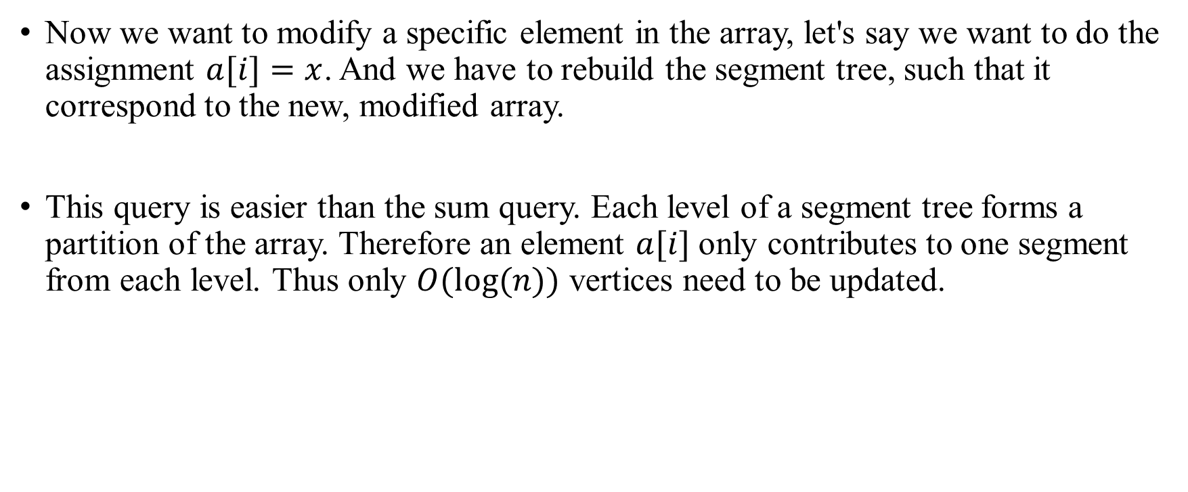
Segment Tree Update queries
Now we want to modify a specific element in the array, let's say we want to do the assignment $a[i]=x$. And we have to rebuild the segment tree, such that it correspond to the new, modified array.
This query is easier than the sum query. Each level of a segment tree forms a partition of the array. Therefore an element $a[i]$ only contributes to one segment from each level. Thus only $O(log⁡(n))$ vertices need to be updated.

Slide 26
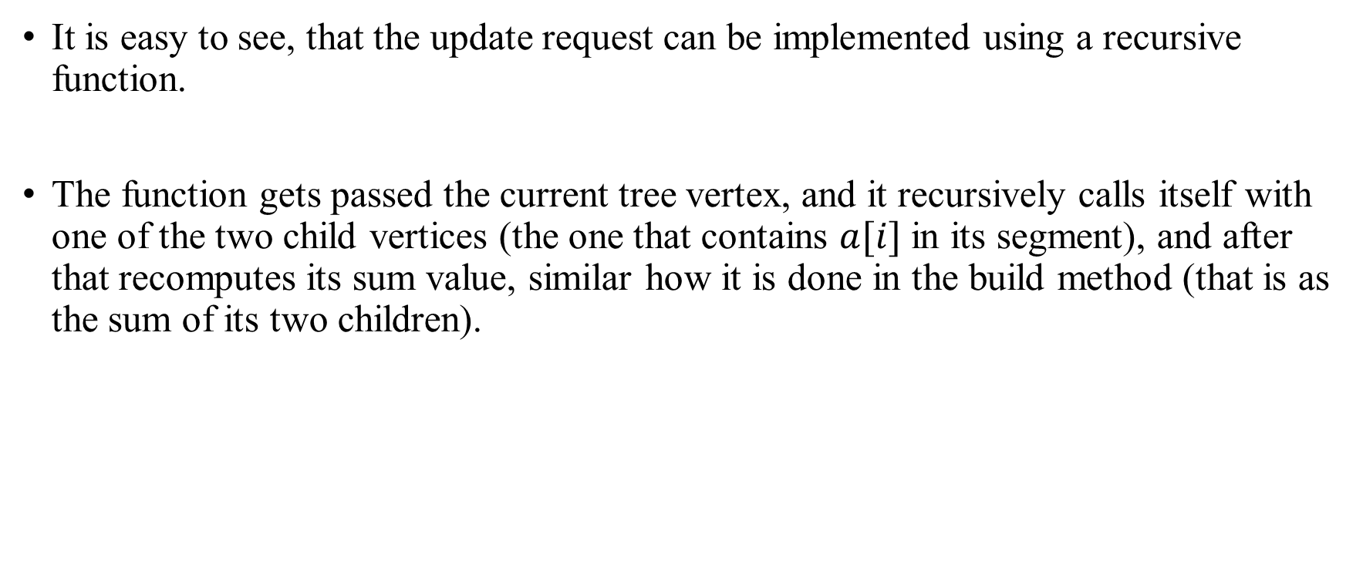
Segment Tree Update queries
It is easy to see, that the update request can be implemented using a recursive function.
The function gets passed the current tree vertex, and it recursively calls itself with one of the two child vertices (the one that contains $a[i]$ in its segment), and after that recomputes its sum value, similar how it is done in the build method (that is as the sum of its two children).

Slide 27

Segment Tree Update queries: Example
Here we perform the update $a[2]=3$. The green vertices are the vertices that we visit and update.
1 | 3 | -2 | 8 | -7
sum = 3
1 | 3 | -2
sum = 2
-2
sum = -2

Slide 28
Segment Tree Update queries: Example
Here we perform the update $a[2]=3$. The green vertices are the vertices that we visit and update.
1 | 3 | -2 | 8 | -7
sum = 3
1 | 3 | -2
sum = 2
3
sum = 3

Slide 29
Segment Tree Update queries: Example
Here we perform the update $a[2]=3$. The green vertices are the vertices that we visit and update.
1 | 3 | -2 | 8 | -7
sum = 3
1 | 3 | 3
sum = 7
3
sum = 3

Slide 30
Segment Tree Update queries: Example
Here we perform the update $a[2]=3$. The green vertices are the vertices that we visit and update.
1 | 3 | 3 | 8 | -7
sum = 8
1 | 3 | 3
sum = 7
3
sum = 3

